Slide 1
NORTH SOUTH UNIVERSITY
Lecture 4
PHI 104
Introduction to Ethics

Slide 2
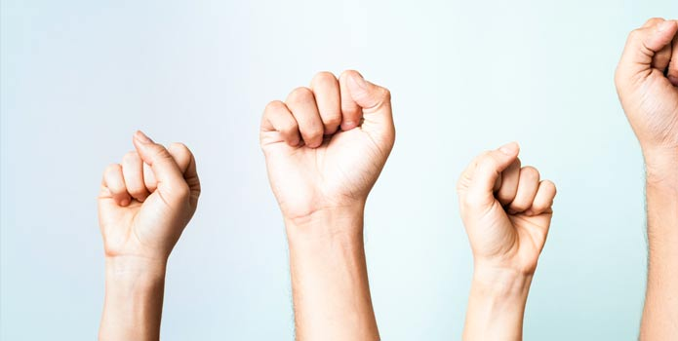

Slide 3
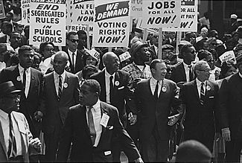

Slide 4
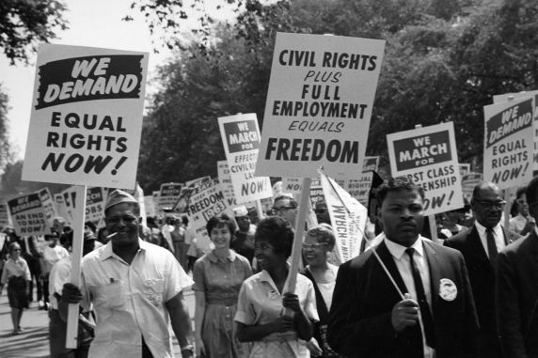

Slide 5
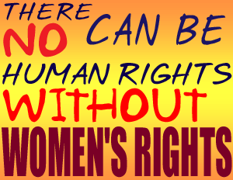

Slide 6


Slide 7
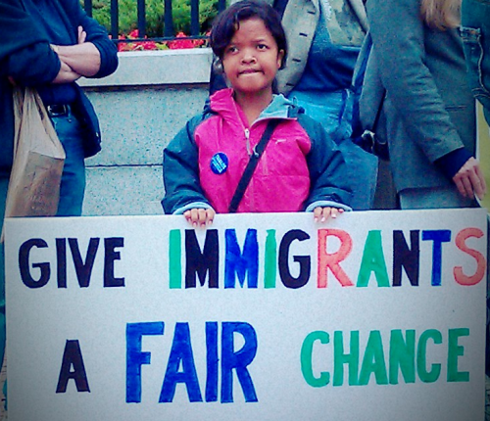

Slide 8
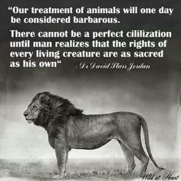

Slide 9
Rights

Slide 10
What is a right?

Slide 11
A right is a justified claim on others.

Slide 12
Beauchamp and Childress, have defined the term "right" to be a "justified claim that individuals and groups can make upon other individuals or upon society”.

Slide 13
For example, if I have a right to freedom, then I have a justified claim to be left alone by others. Turned around, I can say that others have a duty or responsibility to leave me alone. If I have a right to an education, then I have a justified claim to be provided with an education by society.

Slide 14
The "justification" of a claim is dependent on some standard acknowledged and accepted not just by the claimant, but also by society in general. The standard can be as concrete as the Constitution, which guarantees the right of free speech.

Slide 15
Examples
The right to life
The right to liberty
The right to pursue happiness

Slide 16
The right to freely practice a religion of choice
The right to express ideas or opinions with freedom as an individual
The right of individuals or organizations to express opinions or share information freely in written medium
The right to come together and meet in order to achieve goals
The right to be informed of what law has been broken if arrested
The right to call witnesses to speak on one's behalf if accused of a crime

Slide 17
The right of a person to be treated with respect and dignity even after being found guilty of a crime
The right to freely live and travel within the country
The right to work
The right to marry
The right to bear children
The right to free education
The right to join any peaceful parties or groups of choice
The right to be free from slavery

Slide 18
The right to not be tortured
The right to be treated as equal to others
The right to be considered to be innocent until proven guilty
The right to personal privacy
The right to own property

Slide 19
Legal rights
Legal rights are, rights which exist under the rules of legal systems or by virtue of decisions of suitably authoritative bodies within them.

Slide 20
The Second Amendment to the United States Constitution grants Americans the right "to keep and bear arms."

Slide 21
Moral rights
Moral rights are justified by moral standards that most people acknowledge, but which are not necessarily codified in law; these standards have also, however, been interpreted differently by different people.

Slide 22
Types of rights-
Natural and Conventional
l. Natural and conventional - natural rights pertain to us by virtue of our humanity; as such they apply to all persons. Natural rights are commonly called moral rights. Conventional rights are created by humans, generally within the context of social and political organizations.

Slide 23
Negative rights and positive rights
2. Negative and positive -- negative rights impose duties of noninterference on others. Thus my right to life as a negative right is a right not be killed. positive rights impose duties of assistance on others. For example, welfare rights impose on the state the duty to assist those who cannot provide for themselves.

Slide 24
Right to die?

Slide 25
'Goodbye world. Spread good energy': Terminal cancer patient, Brittany Maynard, 29, exercises her right-to-die and takes her own life surrounded by her family.

Slide 26
Brittany Maynard, 29, had previously planned to legally end her life on November 1 - before she loses her battle with terminal brain cancer
She died in her Portland, Oregon home on Sunday surrounded by family.
Chose to die before she lost her ability to function.
Maynard wrote on Facebook: 'Goodbye to all my dear friends‘.
Was diagnosed in April and doctors gave her just six months to live.
She then made headlines around the world announcing she wanted to die.

Slide 27
Exercise
Write at least two recent examples of moral and legal rights movement in global context.

Slide 28
Universal Declaration of Human Rights
On 10 December 1948 in Paris, the General Assembly of the United Nations adopted and proclaimed the Universal Declaration of Human Rights (UDHR). The Declaration was the first international recognition that all human beings have fundamental rights and freedoms and it continues to be a living and relevant document today.

Slide 29
“All human beings are born with equal and inalienable rights and fundamental freedoms”

Slide 30
Non-discrimination, equality and fairness - key components of justice - form the basis of the Declaration. It consists of an introduction and 30 articles that set out a range of fundamental human rights and freedoms to which all men and women, everywhere in the world, are entitled.

Slide 31
Article 1.
All human beings are born free and equal in dignity and rights. They are endowed with reason and conscience and should act towards one another in a spirit of brotherhood.

Slide 32
Article 2.
Everyone is entitled to all the rights and freedoms set forth in this Declaration, without distinction of any kind, such as race, colour, sex, language, religion, political or other opinion, national or social origin, property, birth or other status. Furthermore, no distinction shall be made on the basis of the political, jurisdictional or international status of the country or territory to which a person belongs, whether it be independent, trust, non-self-governing or under any other limitation of sovereignty.

Slide 33
Article 3.
Everyone has the right to life, liberty and security of person.
Article 4.
No one shall be held in slavery or servitude; slavery and the slave trade shall be prohibited in all their forms.

Slide 34
Article 5.
No one shall be subjected to torture or to cruel, inhuman or degrading treatment or punishment.

Slide 35
Class Work
Ethical Problem Analysis:
Should we recognize privacy as a human right?
https://www.nationalmagazine.ca/en-ca/articles/law/in-depth/2020/should-we-recognize-privacy-as-a-human-right

Slide 36
Where is the balance between promoting innovation and protecting privacy?

Slide 37
Write down some recent innovations where AI are used.
Are these innovations threaten humanity or human rights?
Are these innovations threaten our privacy?
Should we limit uses of AI?
Should we have full control over AI installed machines?

Slide 38
Individual Ethics Project Report
“Humor, Ethics, and Dignity: Being Human in the Age of Artificial Intelligence”
By Sean Kanuck

Slide 39
These changes inevitably raise questions about any remaining comparative advantages of humans in the future?
Notions of preserving “humanity”?
and
The conduct of “humane” behavior?

Slide 40
The very first sentence of the Universal Declaration of Human Rights (UDHR)
recognizes the inherent dignity and equality of all human beings as the “foundation of freedom, justice and peace in the world,” and for over seventy years these ideals have guided much of the literature and practice on human rights around the world.
The principles laid out in the UDHR are viewed as fundamental and universal
truths.

Slide 41
In 2014, for example, the Hong Kong venture capital firm Deep Knowledge Ventures appointed a computer algorithm named “Vital” to its board of directors.
Three years later, Saudi Arabia made history by granting citizenship to a humanoid robot called Sophia.

Slide 42
On Being Uniquely Human
Humor and love are often considered to be uniquely human behavioral characteristics.
Ethics and Law
Ethical standards convey normative priorities within any social system, and legal rules seek to enforce value judgments upon human interactions.

Slide 43
The Case for Context
The common factor in all of the preceding discussions about humor, moral dilemmas, voting mechanisms, and judicial systems is that human cognition relies upon
attention to collateral information that exists beyond any specific situation that may be at hand at any given time.

Slide 44
Case Study 1: Driverless Cars
Case Study 2: Lethal Autonomous Weapons
The more cyberspace becomes an automated environment and the more we allow AI into our lives, the more pressing these ethical questions will become.

Slide 45
Humanity must not forego its most essential and unique qualities in order to conform to the limitations of its own inventions. There is a choice to be made, then, about whether we impose limitations on these new technologies in favor of maintaining human control or whether we seek to replicate ethical reasoning and lateral thinking in the machines we create. The answer will have profound effects not only on how we interact with AI but also on how we interact with one another.

Slide 46
Thanks
THANK YOU!!!

